Slide 1

PRE-WRITING
LECTURE 7

Slide 2
Writing
Pre Writing
Drafting
Revising

Slide 3
Writing Process
Brainstorming
Outlining
Rough Draft
Revising
Proof Reading

Slide 4

Revising
Revising is the process of reworking your draft to improve clarity, flow, and impact.
This stage involves making big-picture changes to your content—reordering ideas, rewriting unclear sections, strengthening transitions, and ensuring everything supports your main message.
It’s where good writing becomes great writing.

Slide 5
Proofreading
Proofreading is the final review to catch grammar, spelling, punctuation, and formatting mistakes.
Unlike revising, this step focuses on sentence-level mistakes and fine-tuning details to ensure your work is polished and professional.
A careful proofread helps your writing make the best possible impression on your reader.

Slide 6

What is Pre-Writing ?
The term "pre-writing" has two different meanings.
Hand skills to start Writing.
The first stage of the writing process, followed by drafting, revision, editing and publishing.
Collection of ideas related to a particular topic before writing
Prewriting deserves much time and attention as it helps solve a problem called "writer's block".

Slide 7
How to get start according to Ramet
Do you read extensively?
Have you set aside a time to write each day?
Do you keep a notebook of ideas?
Do you have a good dictionary, thesaurus and access to reference material?
Have you considered how the use of computers impacts on your own writing ambitions?
Are you writing about what you know?

Slide 8
Importance of Pre-writing
The purpose of prewriting is to systematically think, which means to understand how the distinct parts (remember: your position + expert opinion = balanced union of ideas) fit into and influence one another as a whole.
Prewriting techniques help you determine which rhetorical approach to take and how to implement it.
It helps to find out clues how to start.

Slide 9
Pre writing
Invention activities
Arrangement activities

Slide 10



Slide 11

Invention activities
Invention activities available to the beginning writers to choose what is suitable for them.
Out of nonsense and ramblings, something good will come. Some idea will catch fire right there on the page, there will be sparks, and patterns will emerge.
Hit the nail on the head

Slide 12

Brainstorming

Slide 13
Brainstorming
Brainstorming entails generating ideas before writing begins. It’s your opportunity to explore different angles, gather inspiration, and start uncovering what you really want to say. There are many ways to brainstorm. Whether you jot down a list, draw a mind map, or free write without stopping, the goal is to open up possibilities without worrying about structure or quality just yet.

Slide 14
Brainstorming
Finding many solutions of a problem.
Thinking new ideas.
Starting stimulation process to think new ideas.
Think out of the box.

Slide 15


Slide 16
Classic brainstorming techniques
Free writing
Mind mapping
Listing (bulleting)

Slide 17

Free writing

Slide 18
Free writing
Non-liner activity
Fruits in basket
Discard unnecessary ideas
Like using bush on canvas
Freewriting is a writing exercise in which an author writes about whatever they are thinking about, without stopping, for a prescribed about of time. It is similar to stream-of-consciousness writing.

Slide 19
Free writing
It is about flow.
To get the most from this technique, you need to allow your mind to wonder, making connections that lead from one idea to next.
Rather than listing ideas, you freewrite in paragraph form.
But that doesn't mean you should worry about proper sentence structure, spelling, punctuation, or grammar.

Slide 20
Free writing
Good ideas may not appear in the first few minutes of freewriting.
Don’t judge yourself.
Continue writing until the timer goes off.

Slide 21
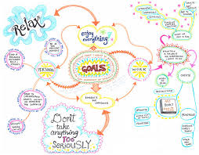
Mind Mapping

Slide 22
Mind Mapping
Mind mapping is a visual brainstorming technique that allows you to see connections between ideas. It provides a clear structure for complex ideas or research topics.
How to do it:
Write your central idea in the middle of a page.
Draw branches outward for related ideas.
Expand with subtopics, creating a web-like structure.

Slide 23

Listing

Slide 24
Listing
Listing is a strategy writers use to brainstorm and write ideas about their chosen topic as they come.
Usually, writers will place each individual point or idea on its own line, either on loose-leaf/notebook paper or in a Word document.
Arrangements of ideas.
Use listing to jot down quickly all ideas.
Use listing for summarizing and exploring new idea from existing ideas.

Slide 25
Collaborative brainstorming methods
Round-robin brainstorming
Brain writing
Rapid ideation

Slide 26
Round-robin brainstorming
Round-robin brainstorming is a group method where participants take turns contributing ideas. This structure helps ensure equal participation and prevents more dominant voices from taking over the discussion. This method is great for writing groups and workshops.
How to do it:
Choose a topic.
Go around the group, having each person contribute an idea.
Continue for a set time or a predetermined number of rounds.

Slide 27
Brain writing
Brain writing is like freewriting—but for teams. Instead of speaking ideas aloud, participants write them down privately before sharing. This method is perfect for introverts, allowing for independent thought before collaboration.
How to do it:
Each participant writes 3–5 ideas on paper.
Pass the papers around so others can build on those ideas.
After several rounds, review and discuss the expanded ideas.

Slide 28
Rapid ideation
This fast-paced technique promotes quick thinking by setting strict time limits. It encourages spontaneity while preventing over analysis—great for tight deadlines or creative jump starts.
How to do it:
Set a timer for 30–60 seconds per idea.
Write down every idea that comes to mind—no pausing, no filtering.
Once the time is up, review and refine your ideas.

Slide 29
Visual brainstorming techniques
Storyboarding
Sketching
The SCAMPER method

Slide 30
Storyboarding
Storyboarding visually maps out concepts, scenes, or sequences, making it easier to organize ideas and plan narratives. This technique is especially useful for fiction writing, screenplays, and video scripts.
How to do it:
Draw a sequence of boxes to represent scenes or key ideas.
Sketch or write a brief description in each box to outline the flow.
Arrange and refine until the story or structure feels cohesive.

Slide 31
Sketching
Some writers think visually, and sketching allows you to use images instead of text to ideate. This approach is great for plot development, scene planning, and article structuring.
How to do it:
Draw symbols, doodles, or simple diagrams to represent ideas.
Use arrows, boxes, or flowcharts to show connections.
Don’t worry about artistic skill—focus on capturing concepts visually.

Slide 32
The SCAMPER method
SCAMPER is a creative problem-solving tool that helps generate new ideas by modifying existing ones. The acronym stands for:
Substitute – Swap out elements for something new.
Combine – Merge ideas to create something fresh.
Adapt – Adjust to fit a different context.
Modify – Change specific details to enhance impact.
Put to another use – Repurpose for a different goal.
Eliminate – Remove unnecessary parts.
Reverse – Flip the structure for a new perspective.

Slide 33
The SCAMPER method
How to do it:
Pick an idea, apply each SCAMPER question, and see where it leads.
This works well for repurposing blog content, refining stories, and improving essays.
Apply SCAMPER to an existing draft to explore new ways to improve it.

Slide 34
Structured analytical brainstorming
Five Whys analysis
Reverse Brainstorming
Six Thinking Hats
Star bursting
SWOT analysis

Slide 35

Five Whys analysis

Slide 36
Questioning
Ask questions
Use investigation approach to answer basic questions of a specific idea
Who? What? When? Where? Why? How?
Use focused and phrased question
It is opposite to thesis statement

Slide 37
Reverse Brainstorming
Instead of solving a problem, this method flips the approach—focusing on how to cause the problem instead. By identifying what not to do, you can uncover hidden challenges and alternative solutions.
How to do it:
Identify the problem or challenge.
Brainstorm ways to make it worse.
Reverse those ideas to find solutions.

Slide 38
Six Thinking Hats
The Six Thinking Hats technique encourages writers to look at their ideas from six different perspectives. Each “hat” represents a distinct way of thinking:
White Hat: Focuses on facts and data.
Red Hat: Considers emotions and intuition.
Black Hat: Identifies potential risks and weaknesses.
Yellow Hat: Highlights benefits and positive outcomes.
Green Hat: Explores creativity and new possibilities.
Blue Hat: Manages the overall process and organization

Slide 39
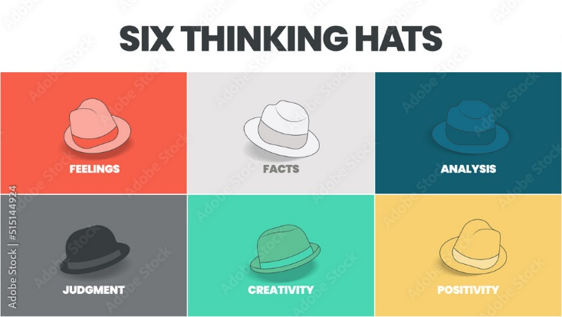

Slide 40
Six Thinking Hats
By mentally “wearing” each hat, writers can develop well-rounded, deeply thought-out ideas. This method is particularly beneficial for persuasive writing, essay planning, and structuring arguments.

Slide 41
Star bursting
Star bursting is a question-driven brainstorming technique that ensures you fully explore an idea before starting a project. It’s especially useful for research-heavy content, blog planning, and structured essays.
How to do it:
Draw a six-point star with your idea in the center.
Label each point with a key question: Who? What? When? Where? Why? How?
Brainstorm as many questions as possible under each category.

Slide 42
SWOT analysis
A SWOT analysis helps evaluate the Strengths, Weaknesses, Opportunities, and Threats of an idea before execution. It’s a structured approach to brainstorming, especially valuable for business writing, nonfiction projects, and long-form content planning.
How to do it:
Draw a four-quadrant grid on a page or a whiteboard.
Label each section:
Strengths: Identify what works well about your idea.
Weaknesses: Consider the challenges or gaps in your argument.
Opportunities: Explore new directions, potential improvements, or trends supporting your idea.
Threats: Analyze possible risks, opposing viewpoints, or competitive challenges.

Slide 43
Digital brainstorming tools
AI-powered idea generators
Mind-mapping software
Voice note brainstorming

Slide 44
AI-powered idea generators
AI-powered tools offer instant writing prompts, structured outlines, and content suggestions tailored to your topic. They help jump-start creativity by introducing fresh perspectives and uncovering new angles you might not have considered.
How to use it:
Struggling to begin an article? Enter a topic or keyword, and it can suggest an outline or tailored writing prompts.
Need fresh ideas? AI-generated suggestions help break creative blocks and serve as a springboard for brainstorming.
Already have ideas? Use AI to refine and expand them further.

Slide 45
Mind-mapping software
Digital mind-mapping tools offer the same benefits as traditional mind maps—but with added flexibility. They help organize ideas visually, connect related concepts, and clarify complex topics. Unlike paper-based mind maps, digital versions make it easy to modify and rearrange ideas effortlessly. (Xmind, coggle
How to use it:
Start with a central idea and branch out into subtopics.
Use drag-and-drop functionality to reorganize ideas as they evolve.
Perfect for outlining stories, structuring essays, and planning research projects.

Slide 46
Voice note brainstorming
Some ideas flow best when spoken rather than written. Voice note brainstorming lets you capture thoughts quickly by speaking them aloud and recording for later transcription. It’s especially useful for writers who think faster than they type or who prefer verbal brainstorming.
How to use it:
Open a voice memo app and talk through your ideas naturally.
Replay and refine—transcribe notes or organize key points into a structured outline.
Mimics natural storytelling, making it ideal for narrative writing, speeches, and brainstorming sessions.

Slide 47

Arrangement activities for

Slide 48
Arrangement activities/ outlining
Webbing
Series of events chain
Fishbone map
Charts
Story maps
Cause and effect diagrams
Timelines
Flowcharts
Venn diagrams

Slide 49
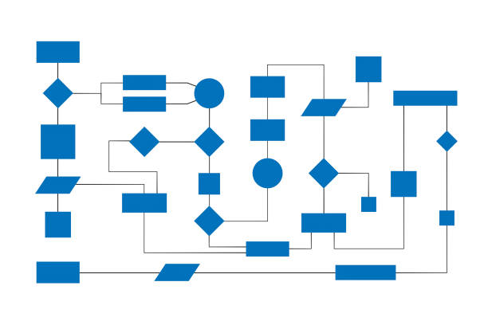
Flowcharts

Slide 50

Series of events chain

Slide 51
Story maps
Story Maps are used for teaching students to work with story structure for better comprehension or Understanding the meaning of text by reading actively and with purpose (for learning, understanding, or enjoyment).
This technique uses visual representations to help students organize important elements of a story.

Slide 52
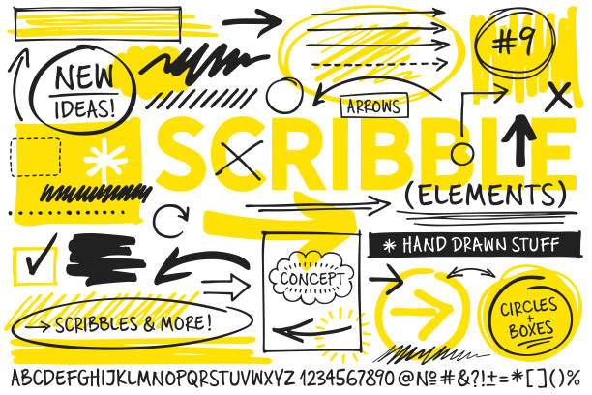
Charts

Slide 53
Charts
"charts" refer to a visual organization tool used to brainstorm.
Structure ideas for a piece of writing by visually mapping out different aspects of a topic.
Often including categories, subcategories, and key details, helping writers organize their thoughts before starting a draft.

Slide 54

Fishbone map

Slide 55
Fishbone map
A fishbone map is a visual brainstorming tool that helps with finding causes of a problem. It is called a fishbone diagram because the finished diagram looks somewhat like the skeleton of a fish.

Slide 56
Fishbone map
Cause category
Cause category
Cause category
Cause category
Effect
Cause category
Cause category
Cause category

Slide 57
Webbing
Write your topic idea in the middle of a page.
Draw lines that radiate out from the topic.
At the end of each line, write down ideas that come to you.
Choose one or more of the ideas and repeat the process.

Slide 58
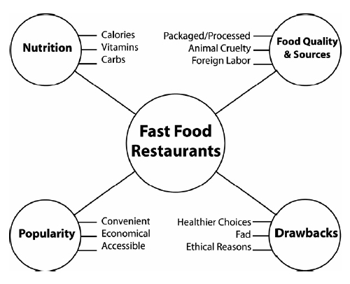

Slide 59
Venn diagrams
A Venn diagram in writing is a visual tool used to compare and contrast two or more ideas, concepts, or items by depicting their similarities and differences through overlapping circles,
where the overlapping area represents shared characteristics and the separate circles represent unique attributes; essentially acting as a graphic organizer to help structure a compare and contrast essay or analysis by visually displaying key points of comparison.

Slide 60
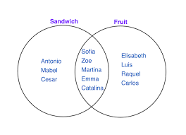

Slide 61

Outlining
Outlining is the act of organizing your ideas into a clear, logical structure. This step helps you decide what belongs where—laying out your introduction, key points, evidence, and conclusion in a way that makes sense. Choosing the right type of outline for your project creates a roadmap that keeps your writing on track and your message focused.

Slide 62
Why create an outline?
Creating an outline can help you organize your ideas, visualize your paper’s potential structure, and further flesh out and develop your points.
It allows you to understand how you will connect information to support your thesis statement and the claims.
An outline provides you with a space to consider ideas easily without needing to write complete paragraphs or sentences.

Slide 63
How to create outline
Before beginning an outline, it is useful to have a clear thesis statement or clear purpose or argument, as everything else in the outline is going to work to support the thesis.
The outline might help inform the thesis, and therefore your thesis might change or develop within the outlining process.
Organize your outline in whatever format fits into the structure needed for the type of paper you are writing. One common outline format uses Roman numerals, letters, and numbers. Other outlines can use bullet points or other symbols.

Slide 64
How to create outline
You can use whatever organizational patterns work best for you and your paper, as long as you understand your own organizational tools.
Outlines can be written using complete sentences or fragments or a mix of the two.
After creating your outline, you may decide to reorganize your ideas by putting them in a different order.
Furthermore, as you are writing you might make some discoveries and can, of course, always adjust or deviate from the outline as needed.

Slide 65
Topic Sentences
Each paragraph should begin with a topic sentence that states the main idea of that paragraph.
Just like the thesis statement, the topic sentence lets you know what the paragraph contains.
For example, for the first paragraph on the causes of smoking, you might write a topic sentence that states: “The most compelling cause of smoking is genetics.”
From this, the reader will know that you will cover the concept of heredity and smoking within this paragraph

Slide 66
Thesis statement
A thesis statement is a clear, concise sentence (or two) that presents the main argument or central idea of an essay, research paper, or article. It sets the direction for the rest of the writing and tells the reader what to expect.
"Regular exercise improves mental health by reducing stress, increasing serotonin levels, and boosting self-confidence."

Slide 67
Sample of outline
Introduction A. Background information B. Thesis
Reason 1 A. Use quotes from x B. Use evidence from y
Reason 2 A. Counterargument 1. They might say… 2. But…
Conclusion A. Connect back to thesis B. Answer the “so what” or “what now” question C. End on a memorable note

Slide 68
Cybercrimes in Pakistan: Challenges, Responses, and the Road Ahead
a relatable scenario highlighting digital vulnerability
a relatable scenario highlighting digital vulnerability
Introduction
Hook (A relatable scenario highlighting digital vulnerability)
Background context (Pakistan’s rapid digitalization)
Thesis statement ( while Pakistan has taken legislative and institutional steps to combat cybercrimes, the nation remains highly vulnerable due to a combination of low digital literacy, an evolving legal framework, and the sophisticated, transnational nature of modern cyber threats, necessitating a multi-faceted approach for effective mitigation)

Slide 69
The Landscape of Prevalent Cybercrimes in Pakistan
Financial cybercrimes
Cyber Harassment and Threats to individuals
Attacks on institutions and National Security
Other crimes
Root causes and contributing factors
Low digital literacy and public awareness
Socio-Economic Factors
Inadequate Technological infrastructure
Transnational Nature of Crimes
The legal and institutional Response
PECA 2016
Key institutions (FIA, PTA)
International cooperation (INTERPOL)

Slide 70
Challenges and gapes in combating cybercrimes
Investigation and Prosecution Hurdles
Underreporting of crimes
Rapidly evolving threat landscape
Recommendations for a safer cyber future
Awareness campaigns
Capacity building
Legal Reforms
Corporate Responsibility
NGO involvement
Conclusion
Restate thesis
Summarize key points
Concluding thought

